Slide 1
Data Discovery
06-06-2023

Slide 2
Our data discovery journey
Theory
Technical implementation
Applied practice

Slide 3
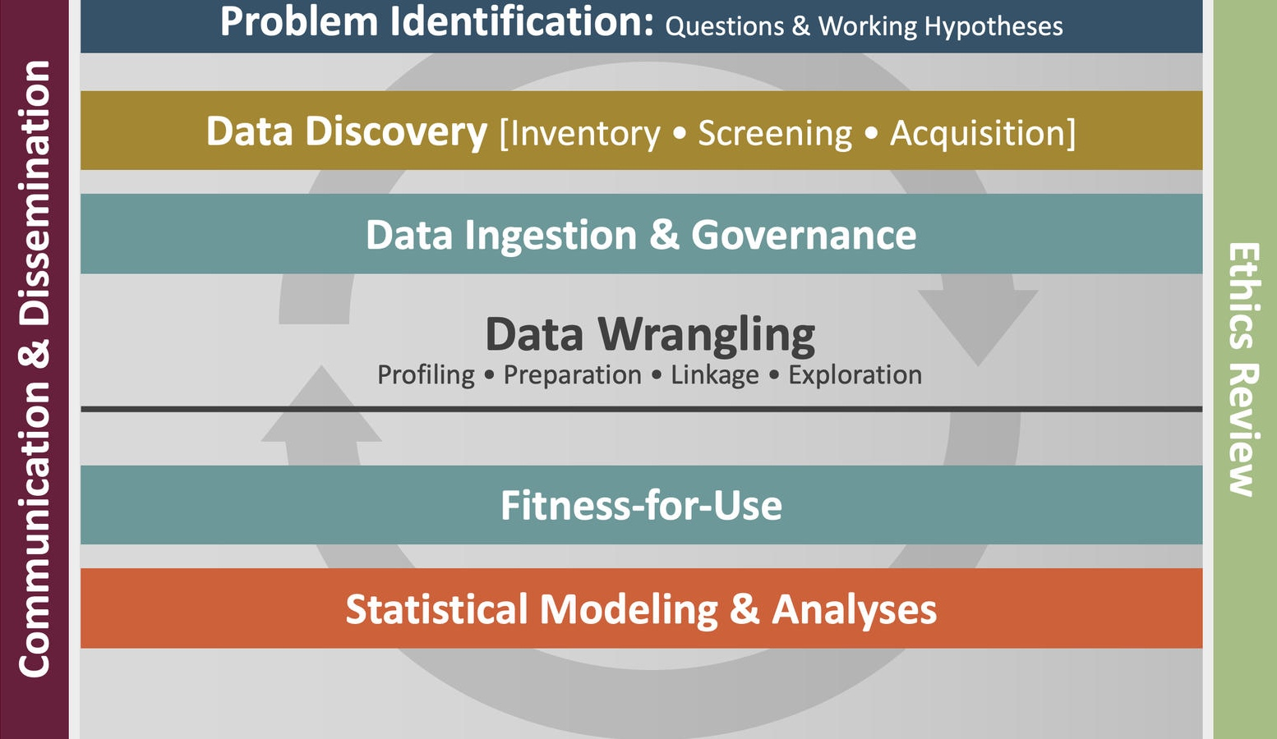
Ethics & Equity Review

Slide 4
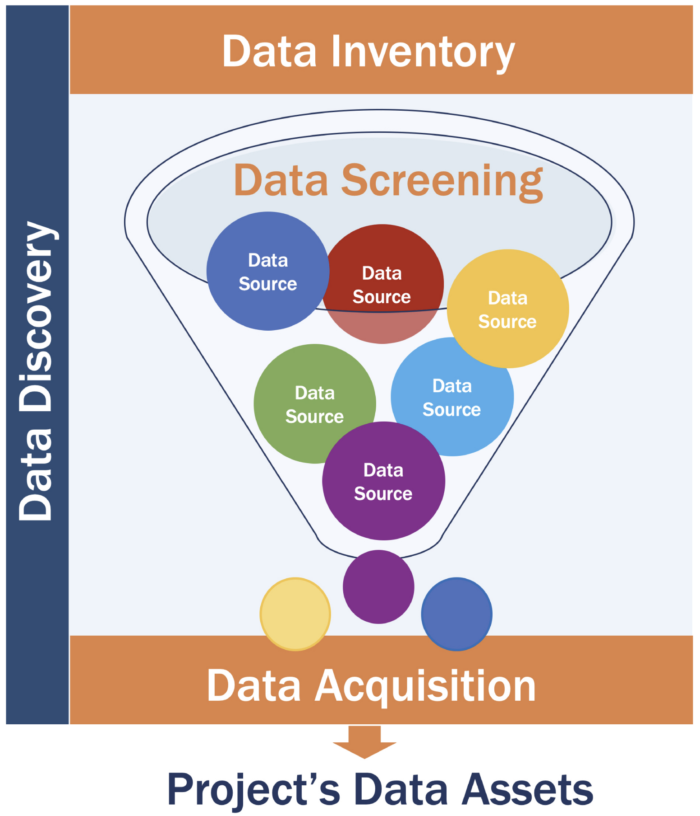
Data discovery filter
Open-ended and continuous process
Data discovery is the open-ended and continuous process whereby candidate data sources are identified.
Data inventory refers to the broadest, most far-reaching ‘wish list’ of information pertaining to the research questions
Data screening is an evaluative process by which eligible data sets are sifted from the larger pool of candidate data sets
Data acquisition is the process of acquiring the data from a sponsor, purchasing it, downloading it using an application programming interface (API), or scraping the web.
Keller, S. A., Shipp, S. S., Schroeder, A. D., & Korkmaz, G. (2020). Doing Data Science: A Framework and Case Study. Harvard Data Science Review, 2(1). https://doi.org/10.1162/99608f92.2d83f7f5

Slide 5
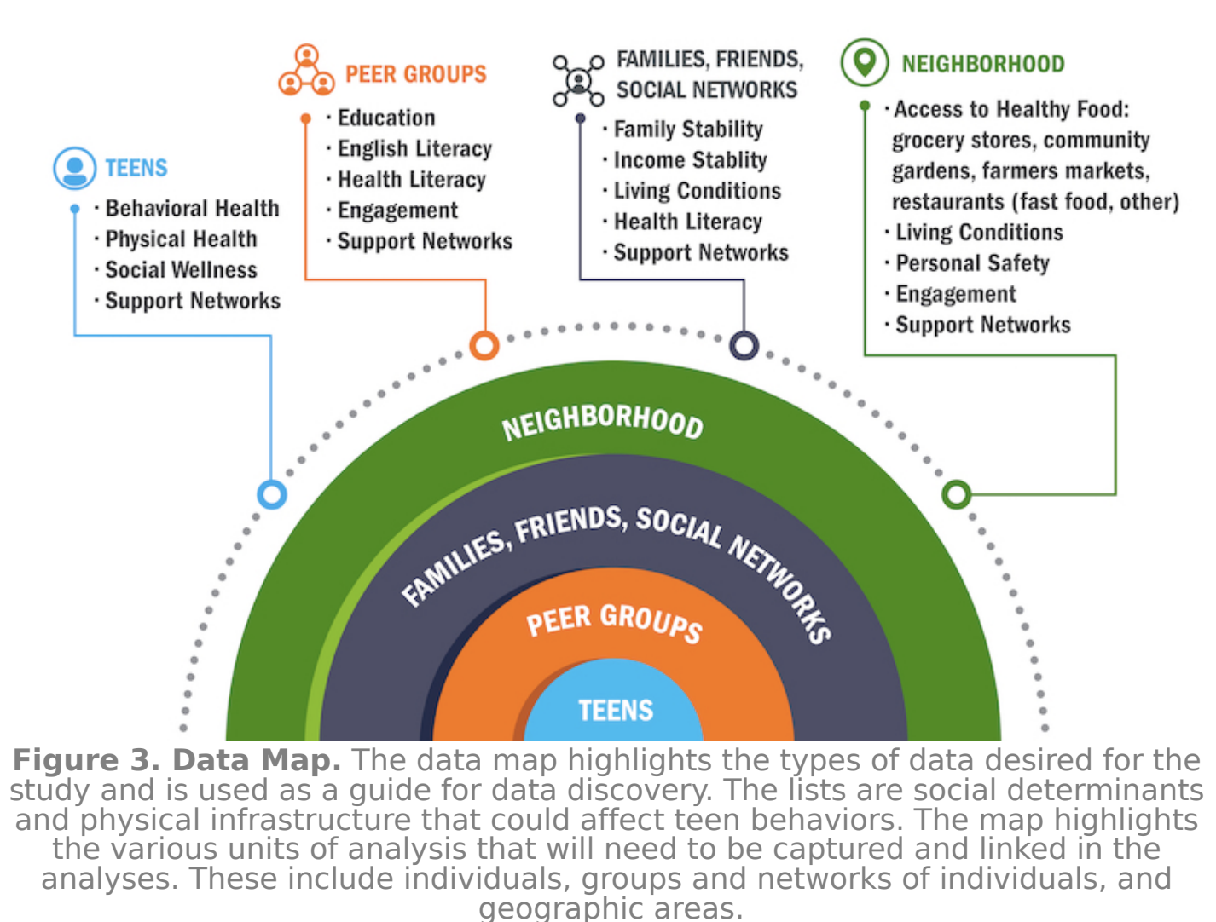
Example Data Map
Keller, S. A., Shipp, S. S., Schroeder, A. D., & Korkmaz, G. (2020). Doing Data Science: A Framework and Case Study. Harvard Data Science Review, 2(1). https://doi.org/10.1162/99608f92.2d83f7f5

Slide 6
Effective Searching
Indexing algorithms
  e.g. GitHub’s code search
Scholarly databases
  Searching with Virgo
Advanced Googling
Subject-specific databases
  Federal sources
  data.gov
  NIH repositories

Slide 7
Example
What is the relationship between income and dog ownership, specifically by dog breed?

Slide 8
Example
What is the relationship between income and dog ownership, specifically by dog breed?
location

Slide 9
DATA INVENTORY
NAME | SOURCE | YEARS | GEO COVERAGE | GEO RESOLUTION | VARIABLES | NOTES
Active Dog Licenses | Arlington Virginia via data.arlingtonva.us | -2023 | Arlington County, VA | Address | currentDogLicenseKey ownerAddressText dogTagNbr dogSexCode spayedNeuteredInd | API available
Austin Animal Shelter Intakes | Unknown via data.world | 2013-2016 | Austin, TX | Unstructured “Found location” | Animal_id Datetime Found_location Animal_type breed | API available
NYC Dog Licensing Dataset | City of New York via NYC Open Data | -2022 | New York City, NY | 22207 | AnimalName BreedName ZipCode LicenseIssuedDate LicenseExpiredDate | API available
South Australian Pet Ownership Data | Unknown via data.world | 2015-2016 | South Australia | State, Region, City | Animal_type Breed_description State Region City Latitude Longitude | API available Lat and long appear to map to city centroids
Petfinder |  | - 2023 | United States | Zipcode, Address? | species Zipcode Address? breed_primary breed_secondary | API available

Slide 10
YOUR TURN

